Slide 1
Welcome to Marketing Management
Dr. Cecilia Ruvalcaba
BUSI 107 Week 9, Day 1

Slide 2
Exam 2
Ethics
Ethical Decision Making
Social Responsibility
Products & Brands
What & Why
Types
Extensions
New Products
What & Why
Diffusion & PLC
Services
Why
Service Variability
Service Characteristics
Service Gaps
Service Recovery
Price
What & How
Price Elasticity & Demand
Break-Even
Price Setting
Price Strategies
New Product Pricing
Pricing Tactics

Slide 3
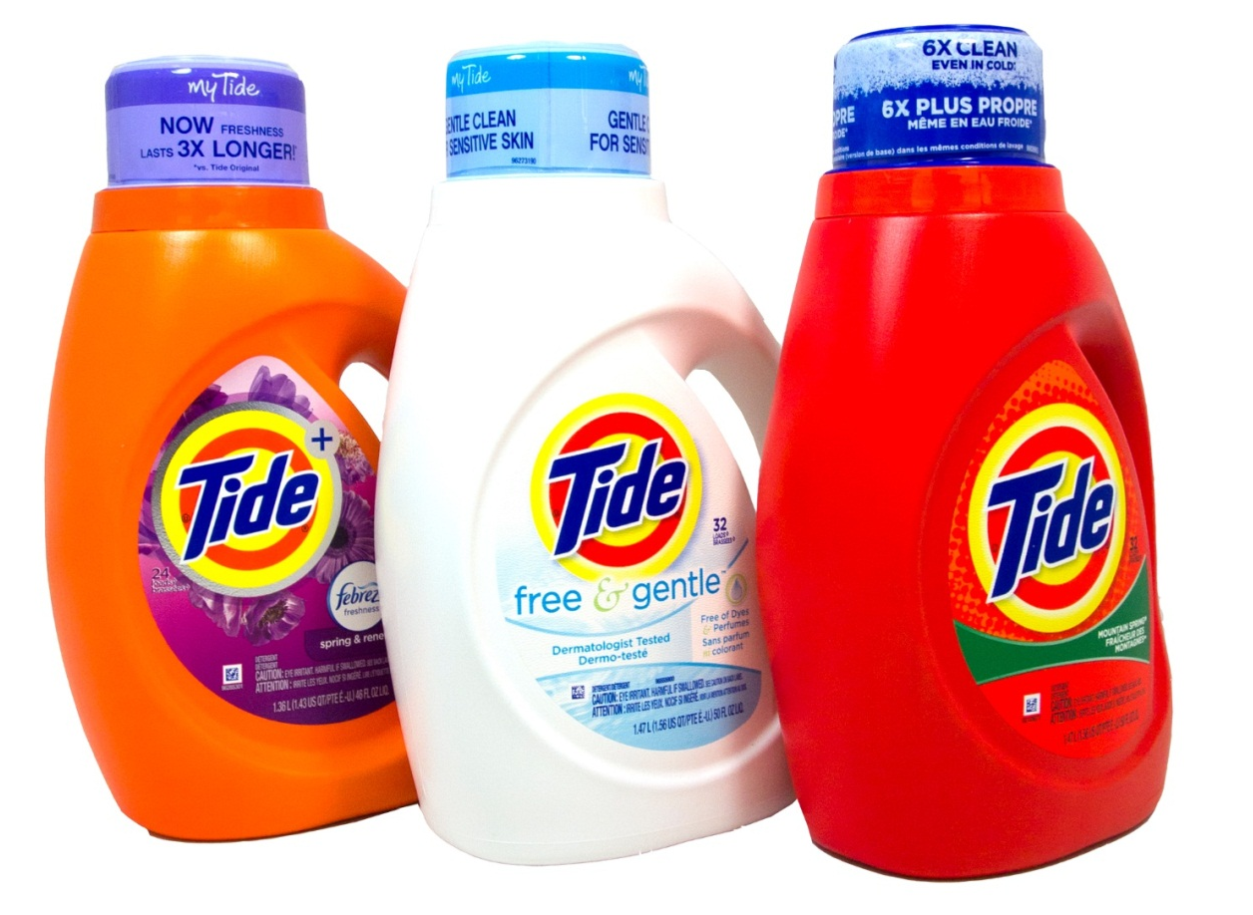
The Price is Right… or is it?

Slide 4
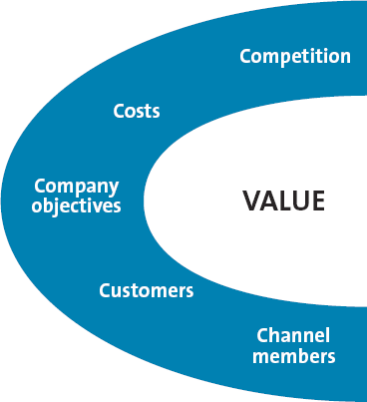
Before setting a price…

Slide 5
Company Objectives & Pricing
Profit-oriented
Sales-oriented
Profit
Orientation
Target
profit
pricing
Maximizing
Profits
Target
return
pricing
Focus on increasing sales
More concerned with overall market share
Does not always imply setting low prices
Competitor- oriented
Competitive parity
Status quo pricing
Customer-oriented
Focus on customer expectations by matching prices to customer expectations

Slide 6
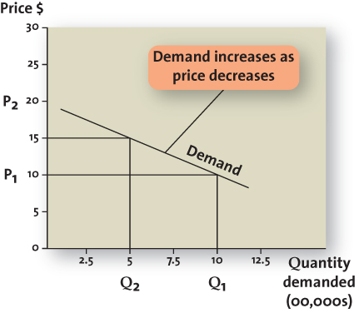
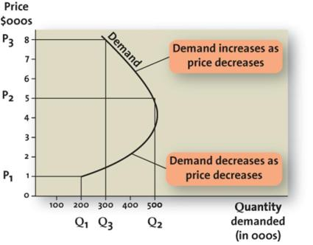
Customers: The Relationship Between Price and Demand
Elastic (price sensitive)
Inelastic (price insensitive)

Slide 7
Factors Influencing Price Elasticity of Demand
Income
effect
Substitution
effect
Cross-
price
elasticity

Slide 8
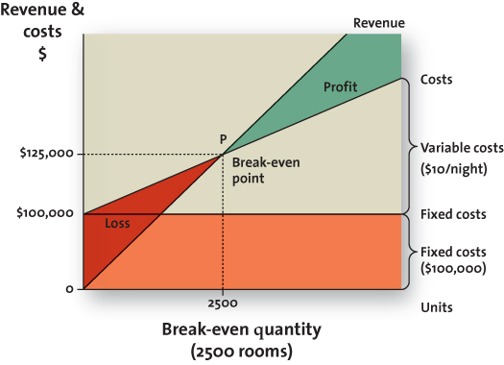
Costs: Breaking Even Analysis
Variable Costs
Vary with production volume
Fixed Costs
Unaffected by production volume
Total Cost
Sum of variable and fixed costs

Slide 9
Break-Even Analysis
Fixed Costs: 1000
Contribution per Unit: $15 - $2 (variable cost) = $13
Break-Even Point = $1000/$13 = 76.9

Slide 10
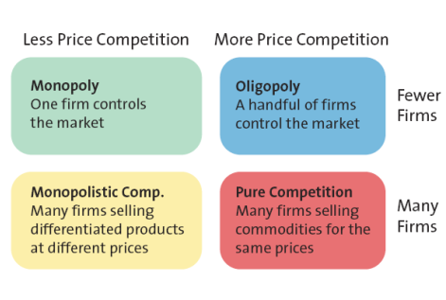
Competition

Slide 11

Channel Members
Manufacturers, wholesalers and retailers can have different perspectives on pricing strategies

Slide 12

Take Away for Today
Price beyond numbers
What is the value?
Branding for loyalty
Decreases price elasticity
Know your 5 C’s before setting a price!

Slide 13

Next Class
Chapter 14 & 15: Price cont…
Exam 2 (Chapters 4, 11-15) Friday 3/25

